Slide 1
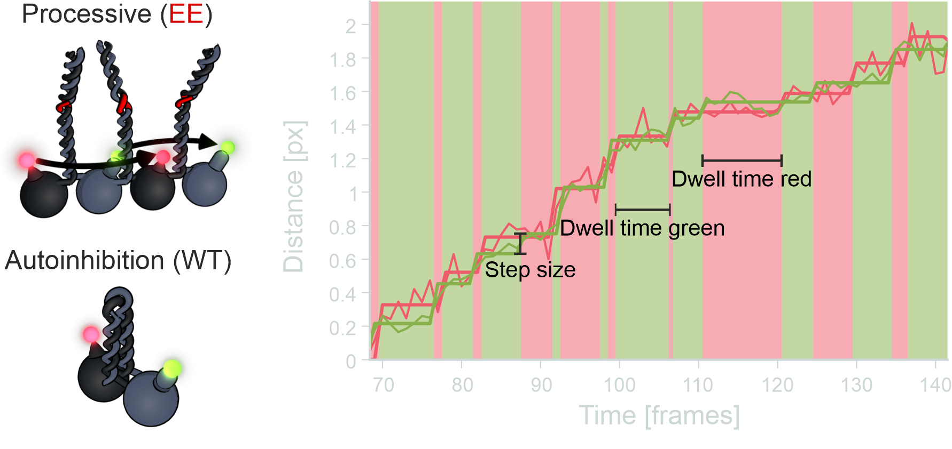

Nanometer imaging of motile specimens
Willi L Stepp¹ & Zeynep Ökten^{1,2}
1 Physik Department E22, Technische Universität München, Garching, Germany
2 Munich Center for Integrated Protein Science, Munich, Germany

Slide 2
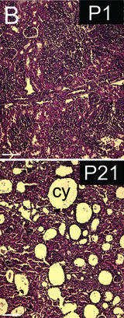
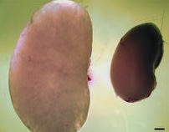
Polycystic kidney disease in mice is linked to a defect in KIF3A
Day 1
normal
Pain medication
Dialysis
Transplantation
No
KIF3A
Day 21
cystic
Kidney-specific inactivation of the KIF3A subunit of kinesin-II inhibits renal ciliogenesis and produces polycystic kidney disease
Lin et al, 2003, PNAS
Notes:
Cilia sense the flow in the renal tubes and the cell reacts with higher Calcium levels.
If a gene called KIF3A is not there, then the cilia are not built the way they should.
This leads to unsuficient transport and the build up of cysts.
Why does this KIF3A lead to misbuilt cilia?

Slide 3
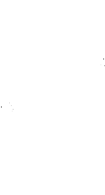
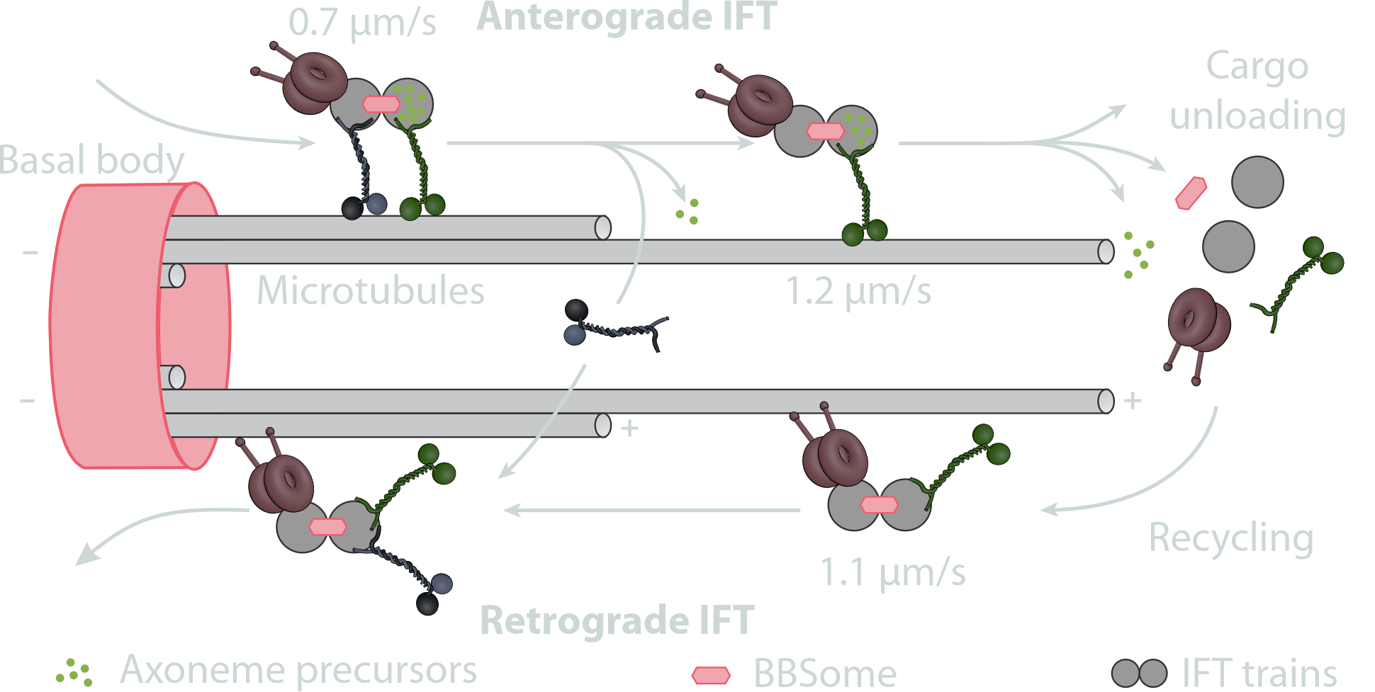
Kinesin-2 is responsible for cargo transport in cilia
Kessel and Kardon
Tissues And Organs
adjusted (Scholey J.M., 2013, Annu Rev Cell Dev Biol)
Notes:
KIF3A is actually a kinesin-2 that works in the intraflagellar tranport building the main structural component of the cilia, the axoneme.
In this transport two motors work together to transport cargo to the tip. At the tip, a dynein that was part of the cargo takes over the transport back to the base, while the kinesins now become a cargo themselves.
In the dense environment of the cilium, this cargo has to be well organized, we will come to this later.
We want to have a very close look at how this motor is working.

Slide 4
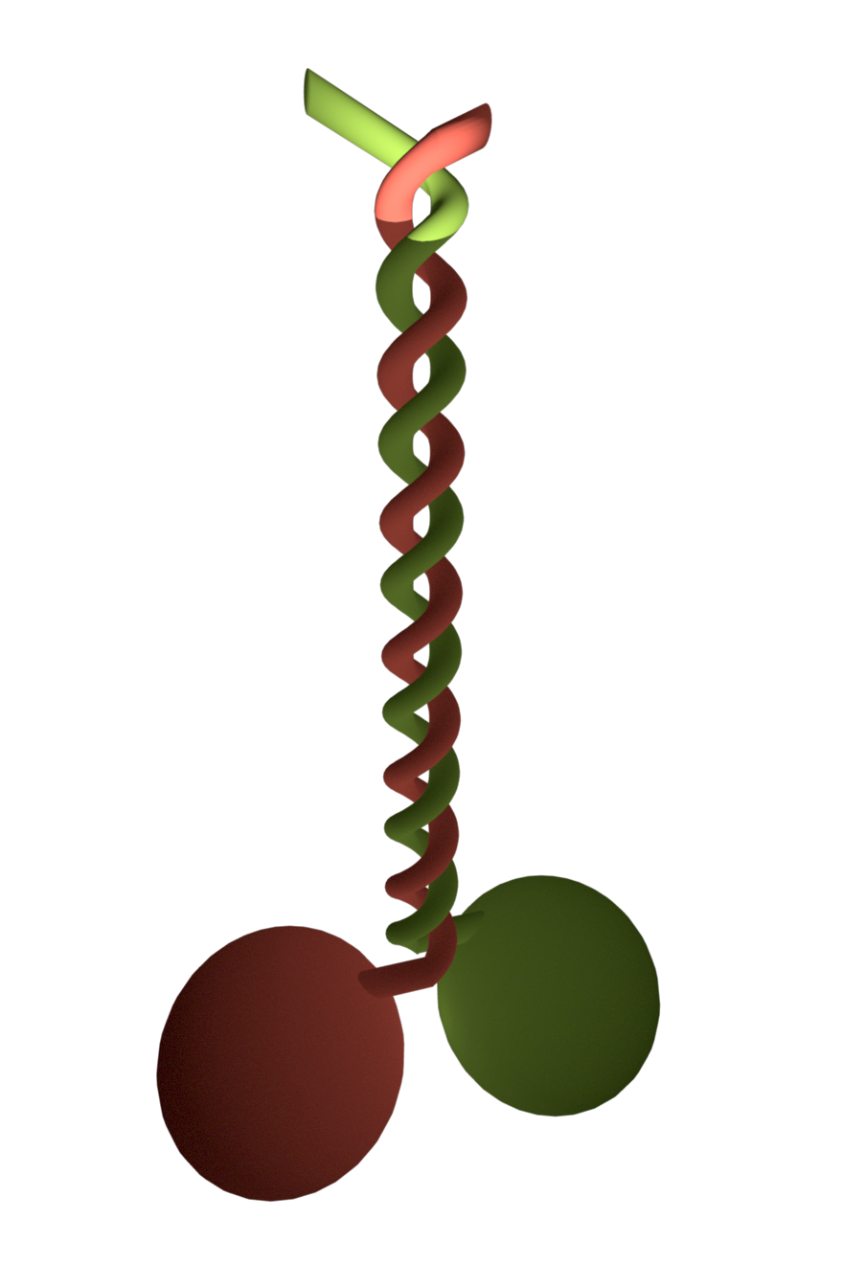
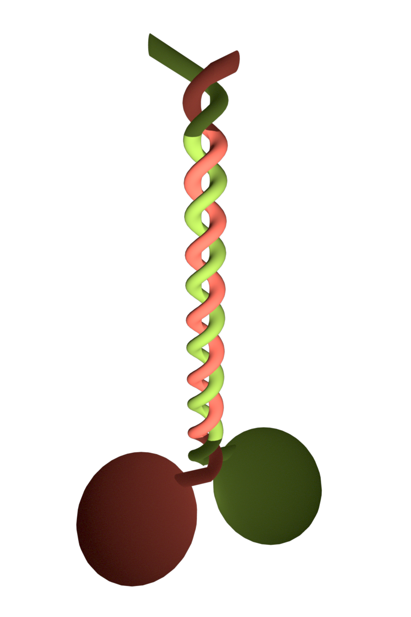
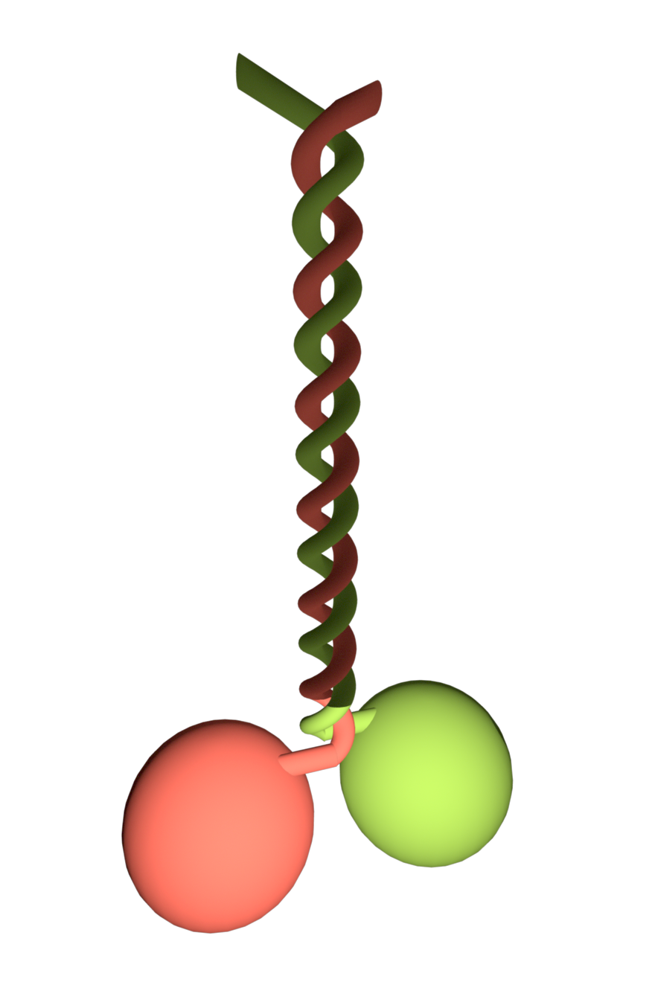
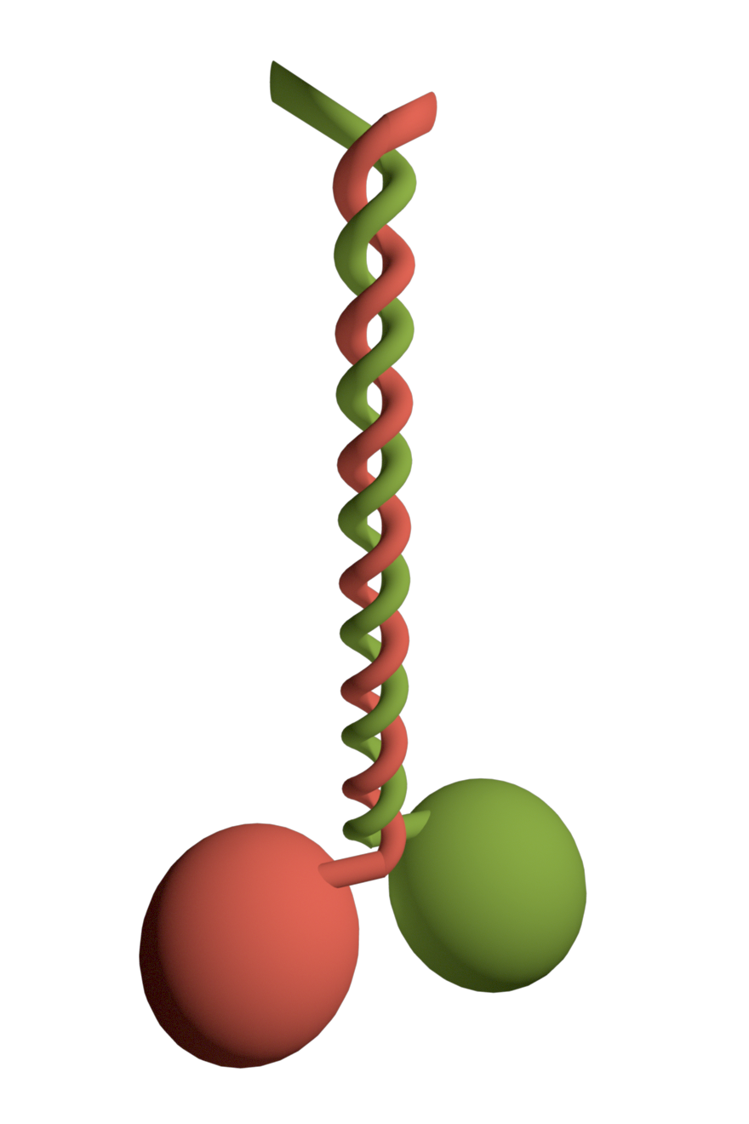
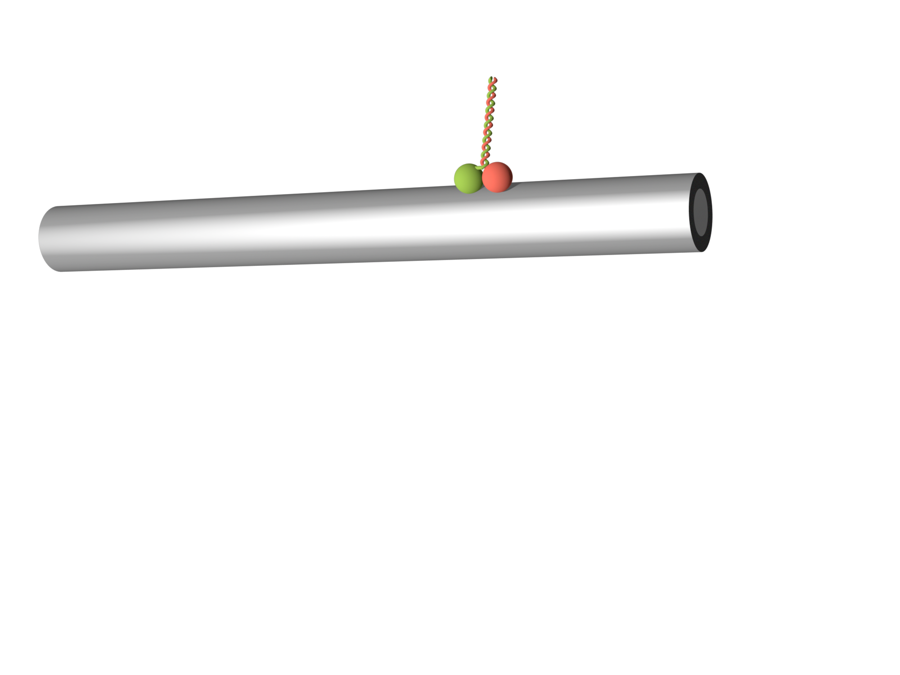
Notes:
The motor is made up of different domains. Heads, that would more intuitively be called feet, because they are responsible for the walking as we will see in a second. The stalk, a coiled coil domain for dimerization of the protein. And tail domains that are responsible for the binding of cargo. Now how is the transport achieved?

Slide 5
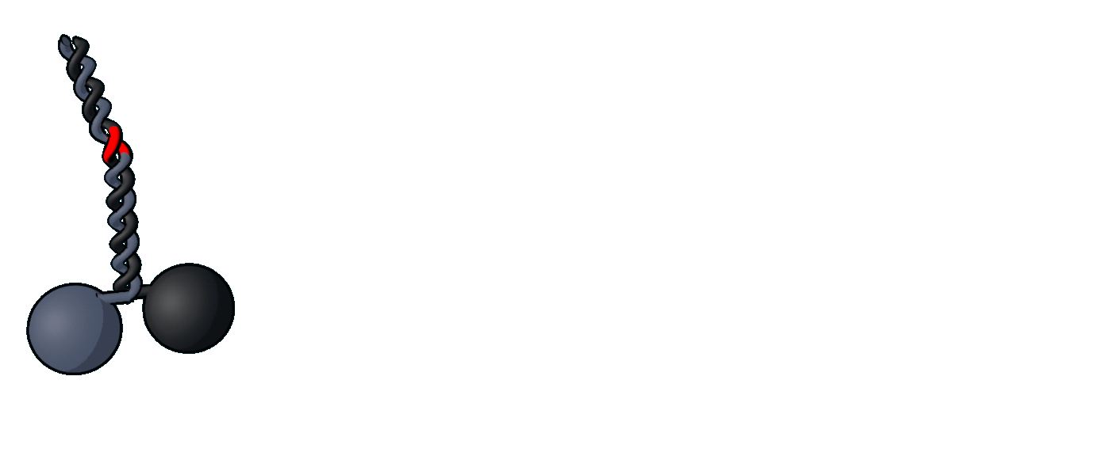



$$\frac{2 m}{20 nm}=1e8$$
$$400 {nm}/s ∗1e8=40 m/s=144 {km}/h$$
$$500 nm ∗1e8=50 m$$
Notes:
Using the energy of ATP-hydrolysis the motor moves forward on ist track. As track it uses microtubules, that have a very well defined lattice of binding sites for the heads. By a mechanism in which the trailing head always overtakes the other head it moves forward. What are important parameters for a motor? Well speed obviously… but also what nowadays becomes more important for cars, how far does it go -> run-length. These parameters can be measured by looking at the net movement of the motor -> what was traditionally done. A bead or a fluorophore to the tail and track the motor. -> also measurement of the force the motor can produce.
We only need motors in very specific places in the cell, so we need an off-switch. -> auto-inhibition

Slide 6
EE
Wild-type
Notes:
Normally the motor is in this collapsed state, where the tail interacts with the heads and inhibits activity. A mutation in the stalk stretches the stalk out and reduces the influence of the tails on the heads.

Slide 7
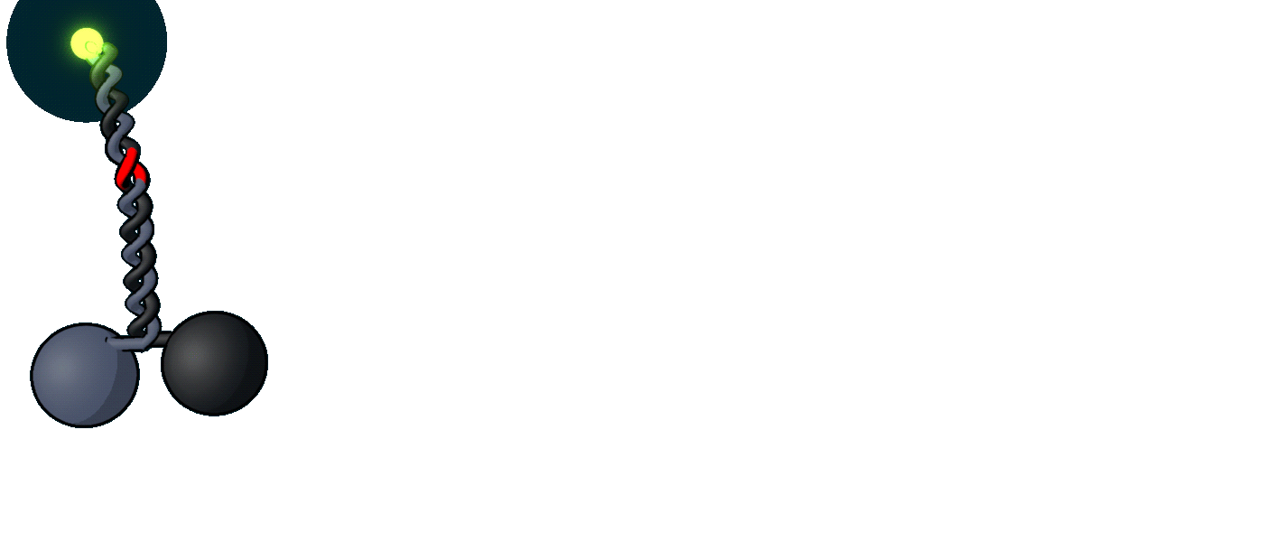

Slide 8
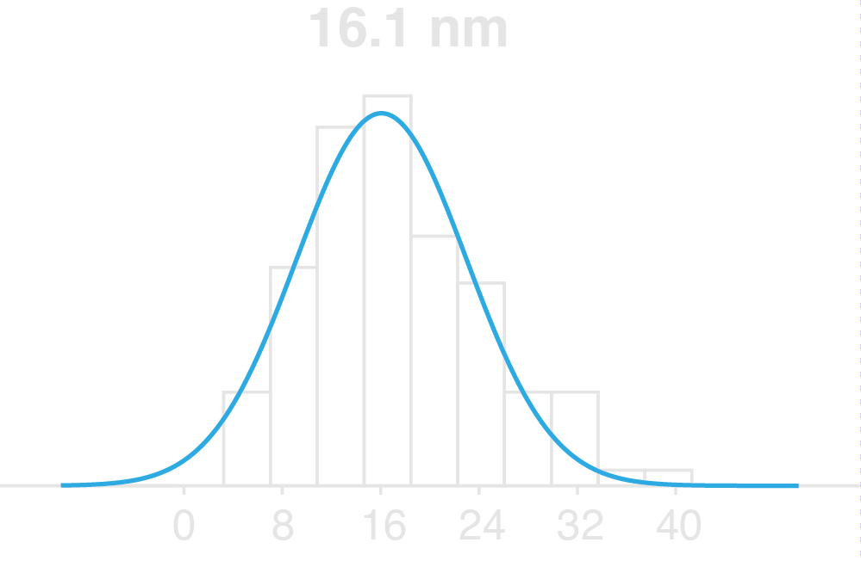
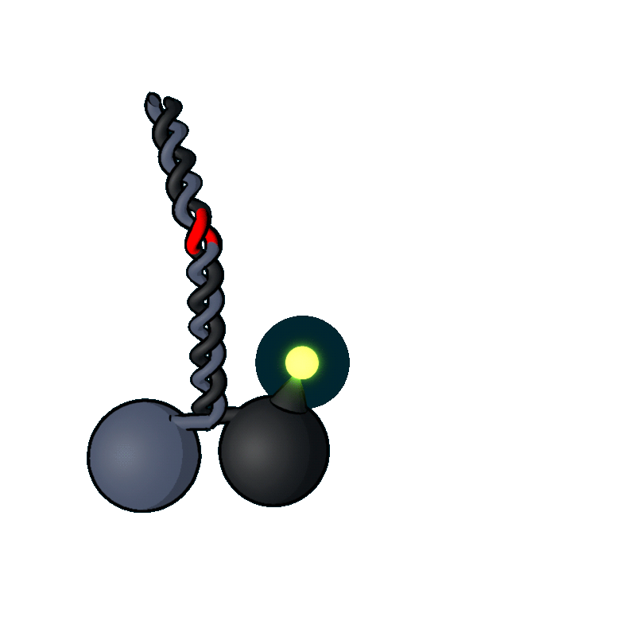
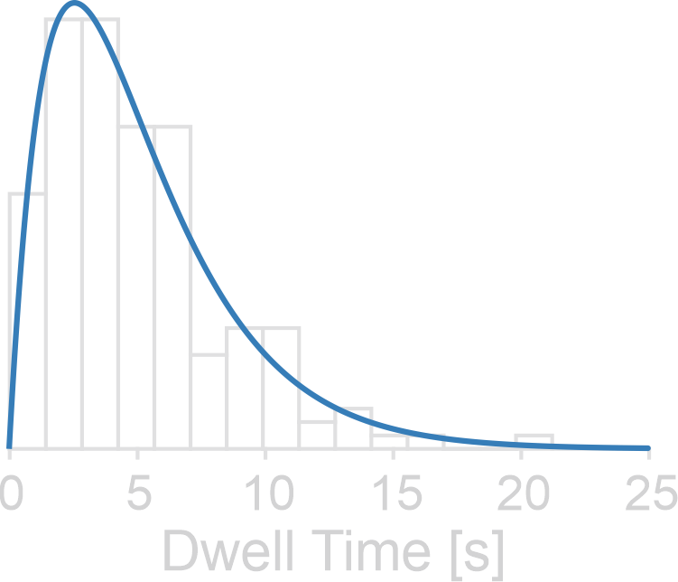
Step Size [nm]

Slide 9
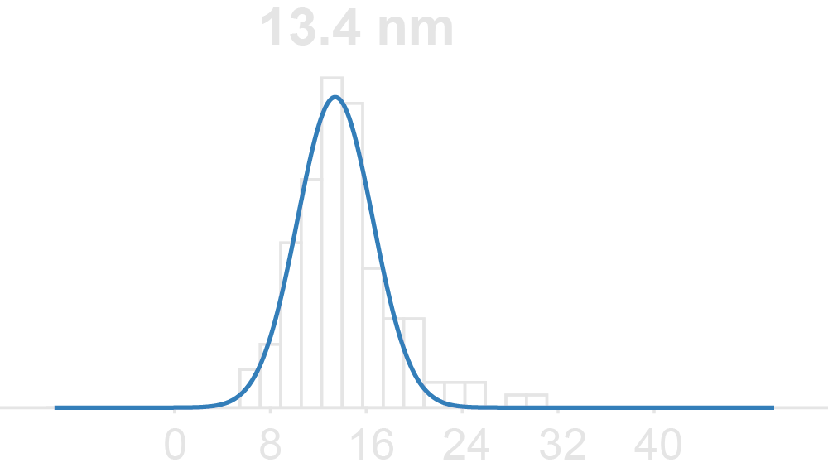
Axonemes
Microtubules
Stepp et al., EMBO Rep 2017

Slide 10
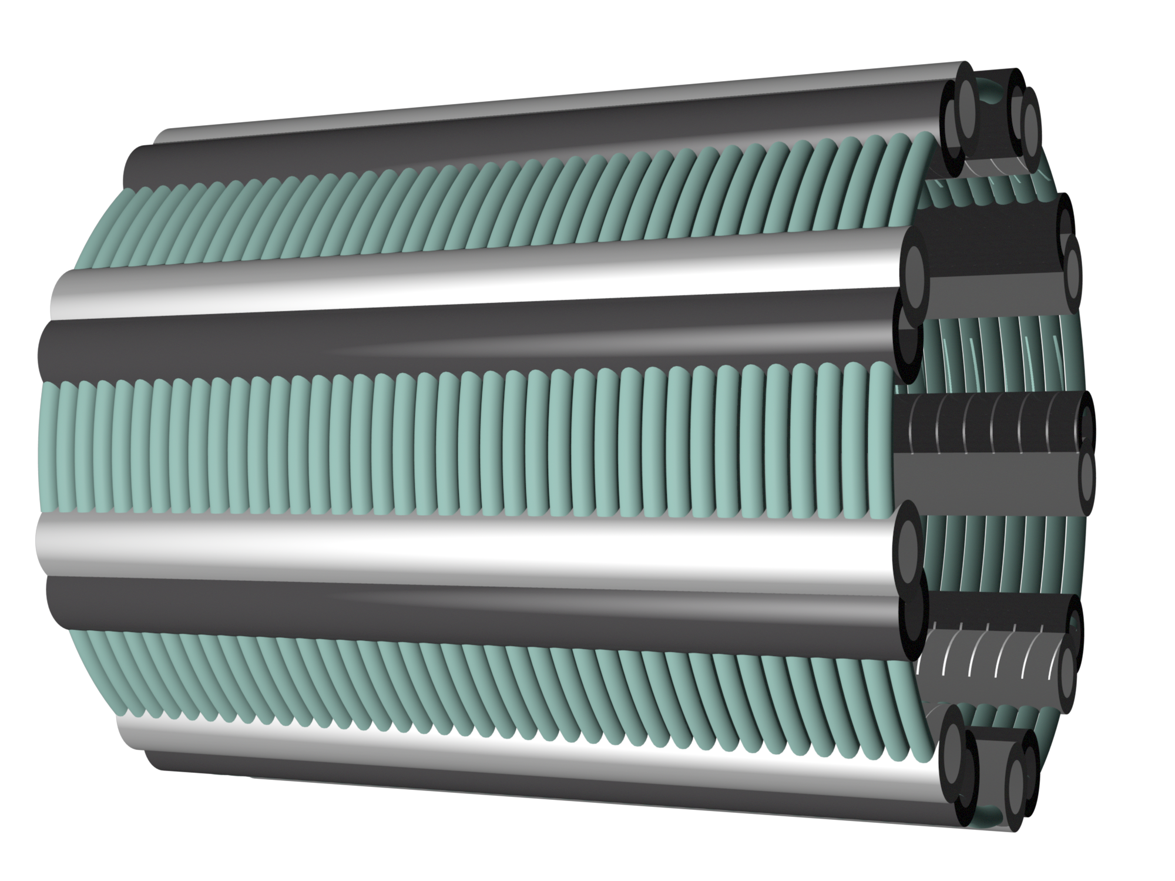
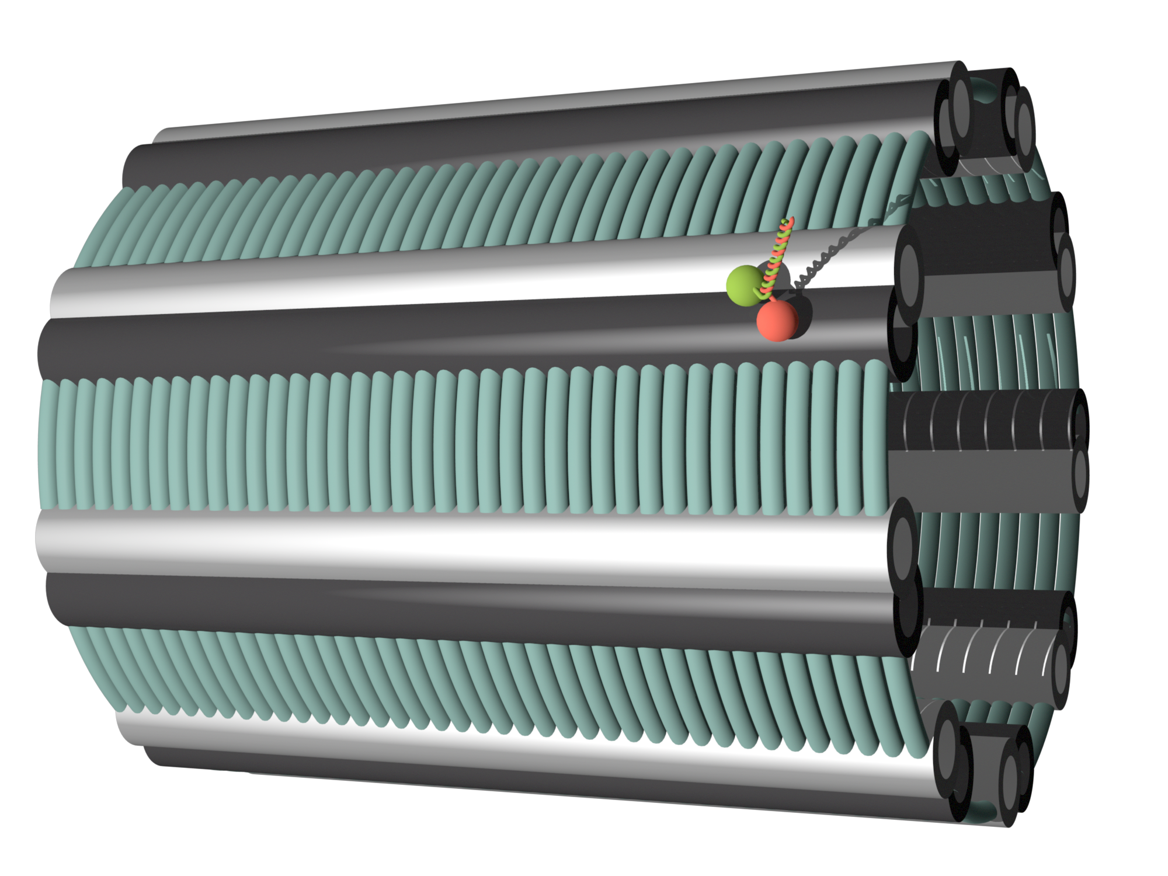
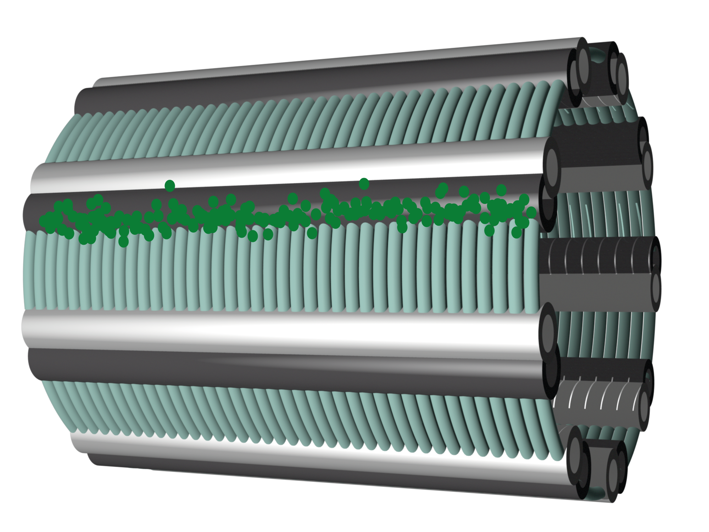
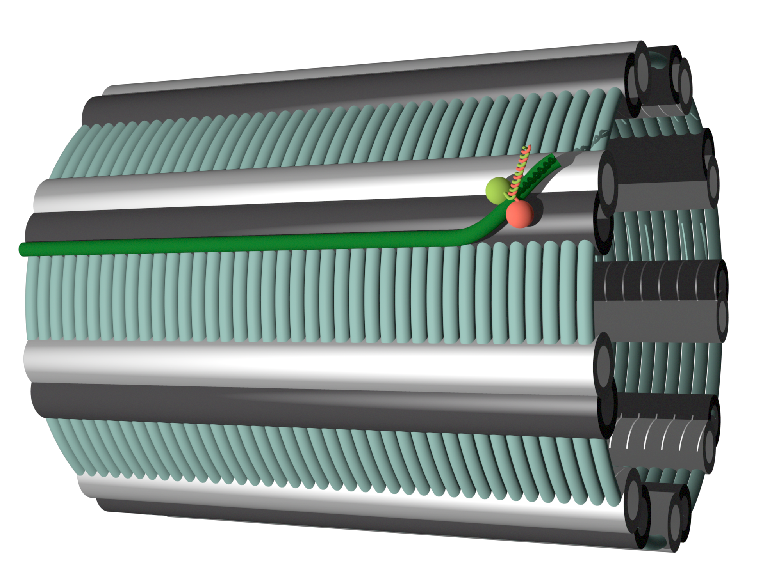
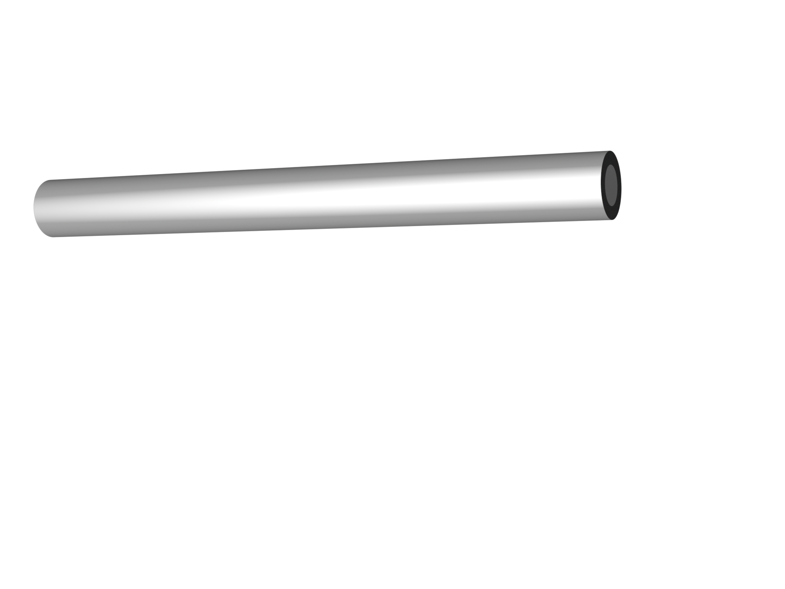
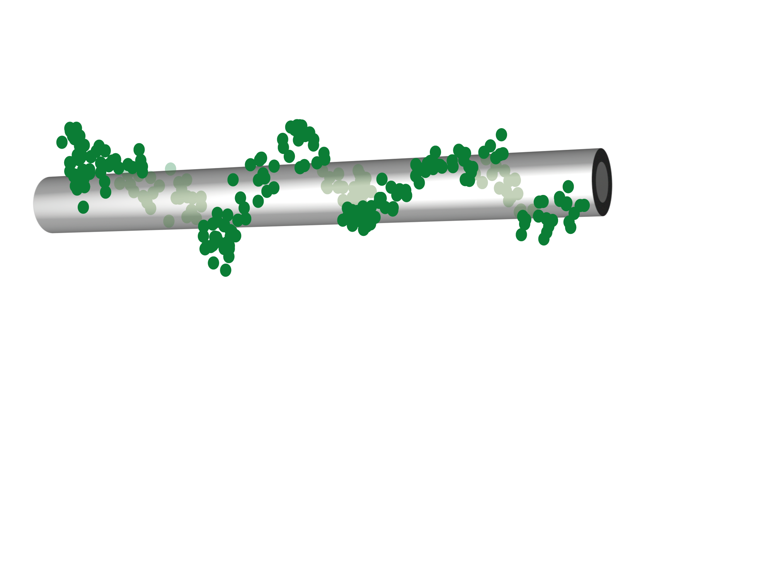
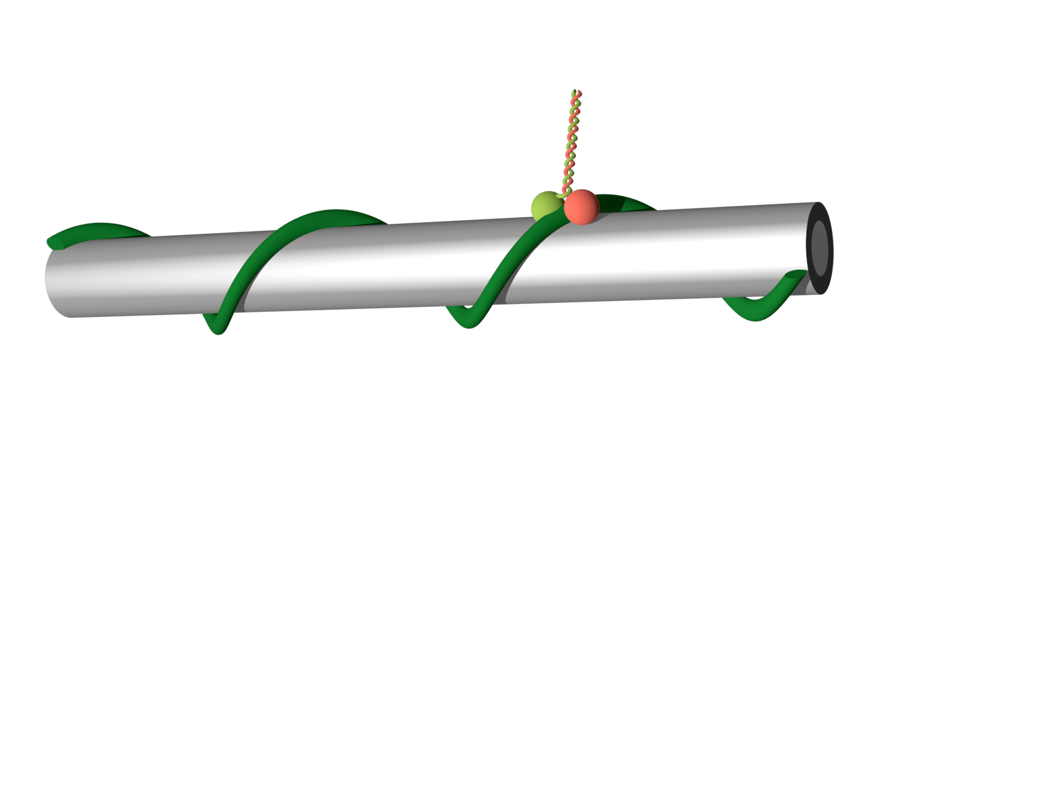

Slide 11
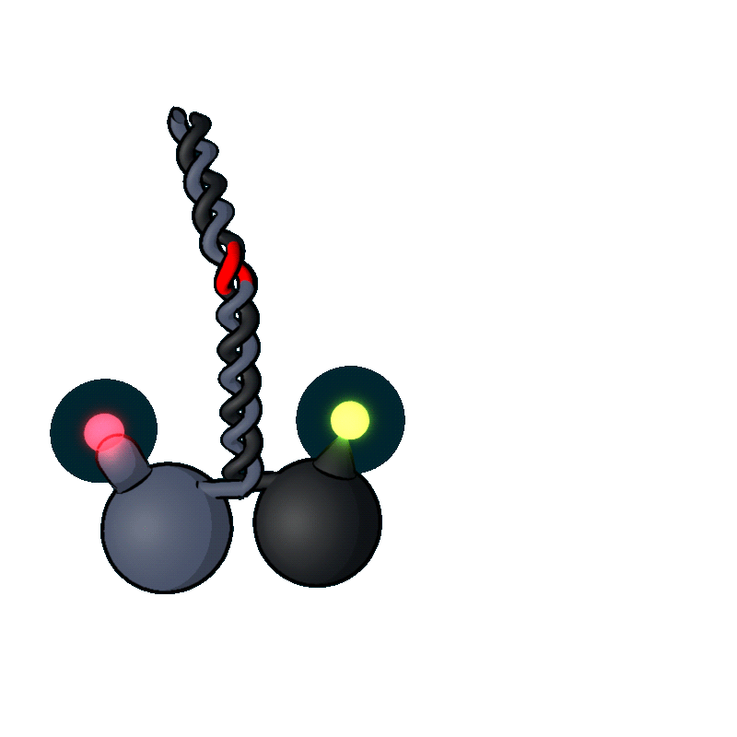

Slide 12
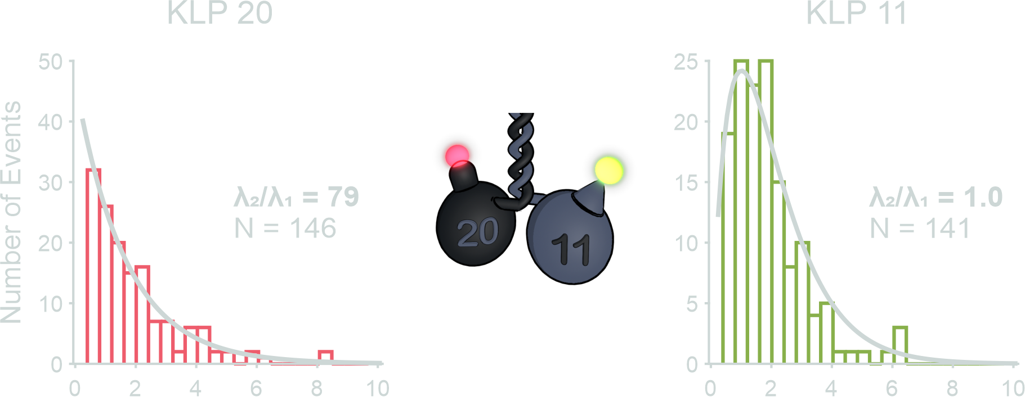
Dwell times [s]
Dwell times [s]

Slide 13
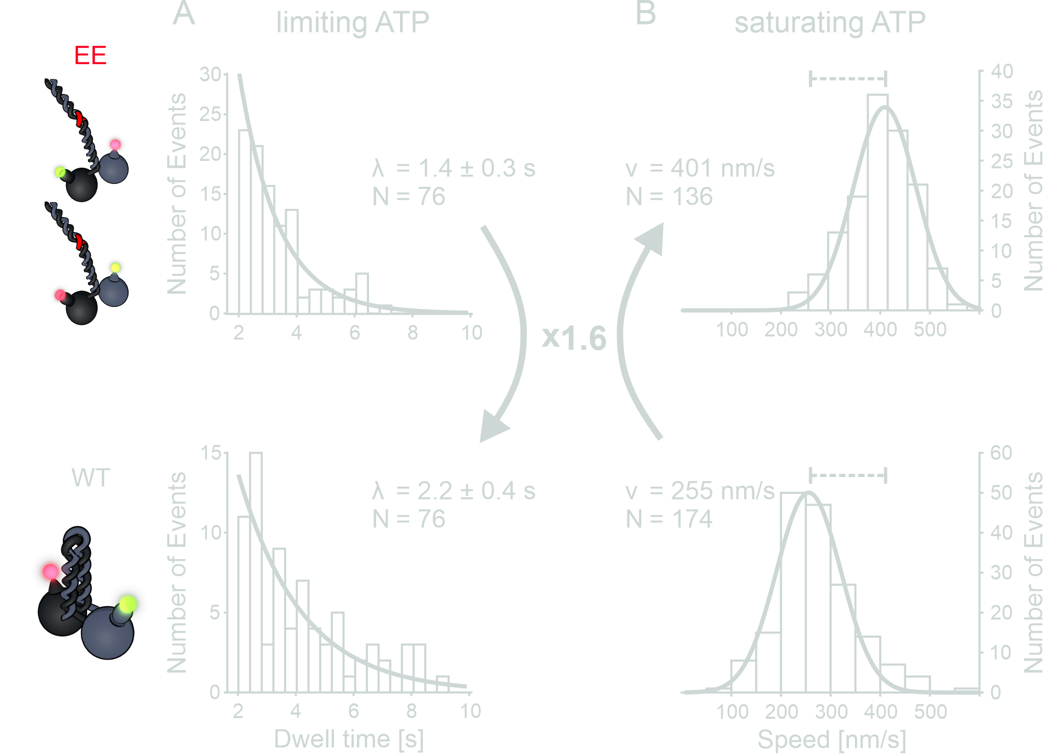

Slide 14
1.4 s
40 ms
X 1.6
2.2 s
62 ms

Slide 15
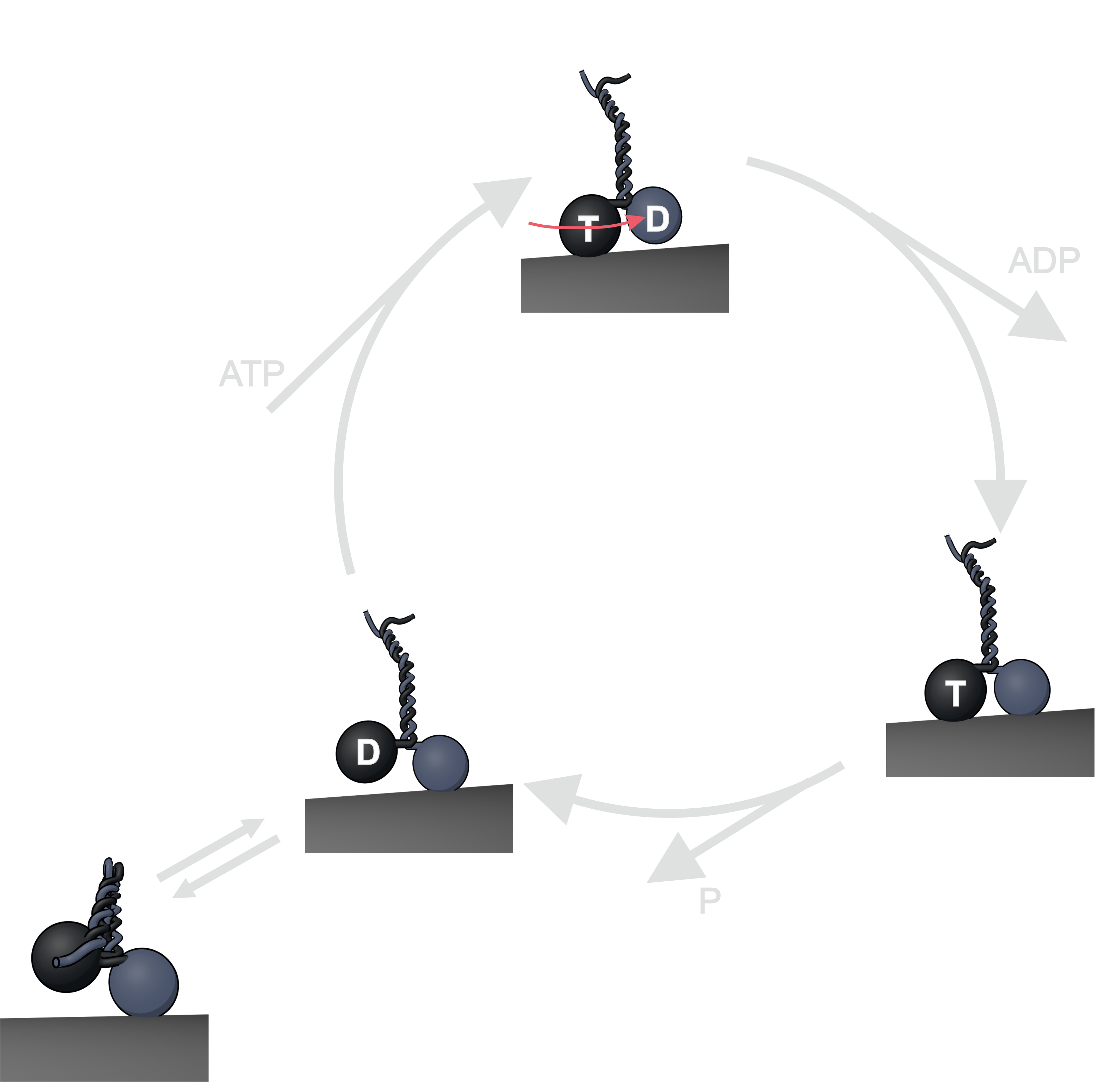

Slide 17
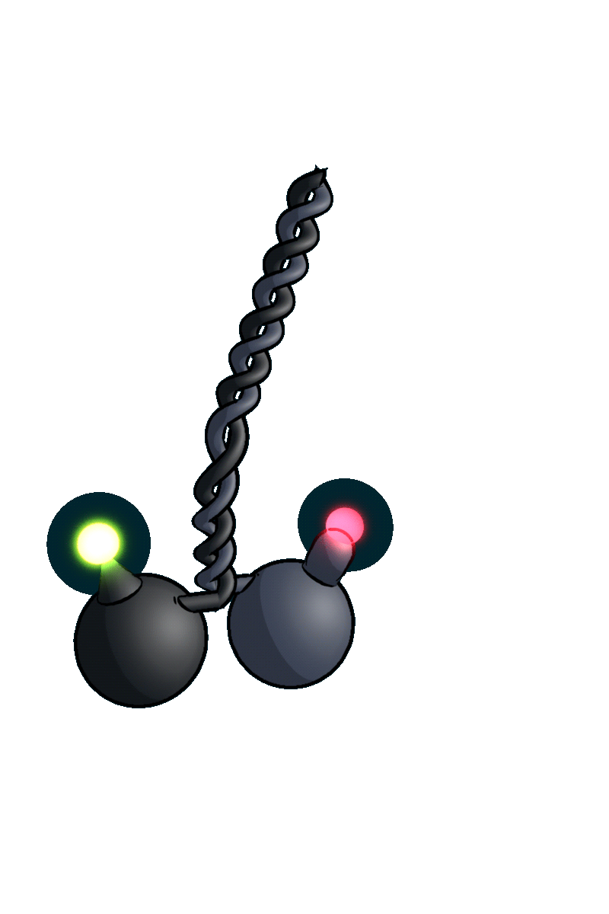
Thank You!

